Slide 1

Housing Price Prediction
Submitted by: VICKY

Slide 2
Introduction
Houses are one of the necessary need of each and every person around the globe and therefore housing and real estate market is one of the markets which is one of the major contributors in the world’s economy. It is a very large market and there are various companies working in the domain.
Data science comes as a very important tool to solve problems in the domain to help the companies increase their overall revenue, profits, improving their marketing strategies and focusing on changing trends in house sales and purchases. Predictive modelling, Market mix modelling, recommendation systems are some of the machine learning techniques used for achieving the business goals for housing companies. Our problem is related to one such housing company.

Slide 3
Problem Statement:
A US-based housing company named Surprise Housing has decided to enter the Australian market. The company uses data analytics to purchase houses at a price below their actual values and flip them at a higher price. For the same purpose, the company has collected a data set from the sale of houses in Australia.
The company is looking at prospective properties to buy houses to enter the market. You are required to build a model using Machine Learning in order to predict the actual value of the prospective properties and decide whether to invest in them or not. For this company wants to know:
Which variables are important to predict the price of variable?
How do these variables describe the price of the house?

Slide 4
Business Goal:
You are required to model the price of houses with the available independent variables. This model will then be used by the management to understand how exactly the prices vary with the variables. They can accordingly manipulate the strategy of the firm and concentrate on areas that will yield high returns. Further, the model will be a good way for the management to understand the pricing dynamics of a new market.

Slide 5
Data Preprocessing/Assumptions
Apply Exploratory Data Analysis (EDA):
Shape of Train Data: 1168 Rows and 81 Columns.
Shape of Test Data: 292 Rows and 80 Columns
Data Types: Some features are Numerical in Nature and some are object data types.
Find data information.
Apply Unique Values approach to find all features unique values.
Find Null Values: Null Values present in both datasets.
Data Cleaning: Treatment of Null Values and dropping not highly related features.

Slide 6
Visualization
Checking Null values by Heatmap.
Analyzing all Features by Univariate Analysis.
Correlation.
Statistical Summary.

Slide 7
Encoding
In our datasets some features are categorical and some are numerical in nature. We are encoding all features into numerical form to analysis the data statistically.
We are using Label Encoder for encoding to encode all features.

Slide 8
Splitting All data into Independent variable and Target variable
Here we are separating target and independent variable for model deployment. As we know, We applied all approaches on data i.e. Data Cleaning, Data Encoding, Data Scaling, Feature Engineering know we are applying all machine learning algorithms for prediction.

Slide 9
Model/s Development and Evaluation
Liner Regression Algorithm:
Liner Regression Algorithm performing Excellent and Its accuracy score is 92 % approx.
Random Forest Regressor:
Random Forest Regressor Algorithm performing Excellent and Its accuracy score is 92 % approx.
Decision Tree Regressor:
Decision Tree Regressor Algorithm performing Very good and Its accuracy score is 80 % approx but is less than above algorithms.
AdaBoost Regressor:
AdaBoost Regressor Algorithm performing Excellent and Its accuracy score is 92 % approx.

Slide 10
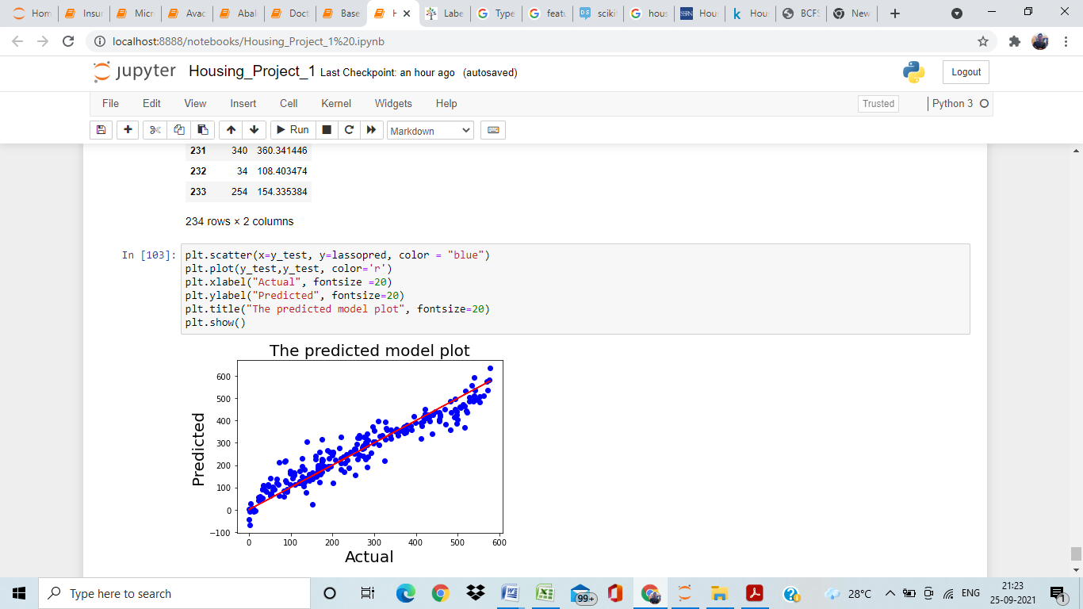
Prediction

Slide 11
Conclusion
In this paper, we built several regression models to predict the price of some house given some of the house features. We evaluated and compared each model to determine the one with highest performance. We also looked at how some models rank the features according to their importance. In this paper, we followed the data science process starting with getting the data, then cleaning and preprocessing the data, followed by exploring the data and building models, then evaluating the results and communicating them with visualizations.

Slide 12
THANK YOU

